Slide 1
Invent your own brush.
Art & Technology
20201131
Hyunwoo Rhee
#07
Intro to Creative Computing

Slide 2
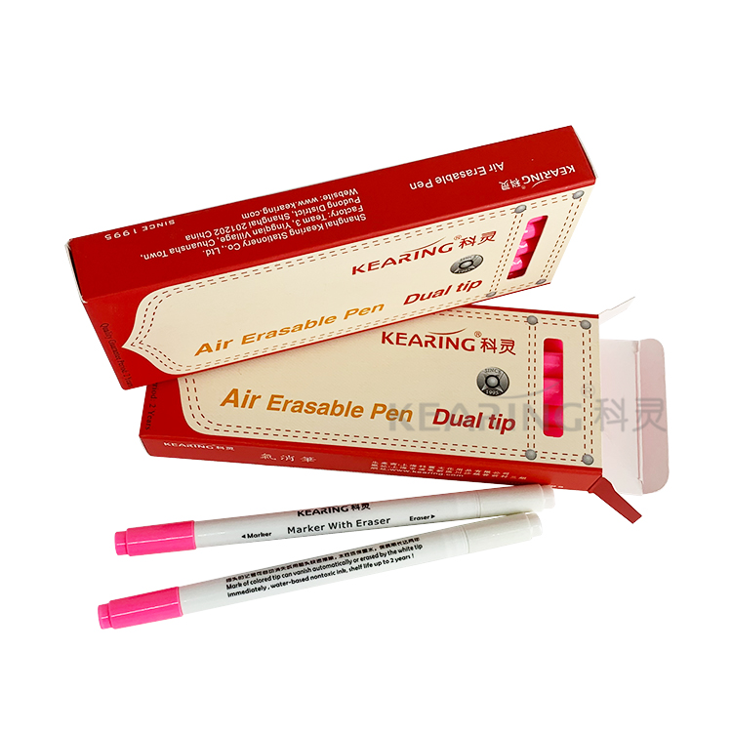

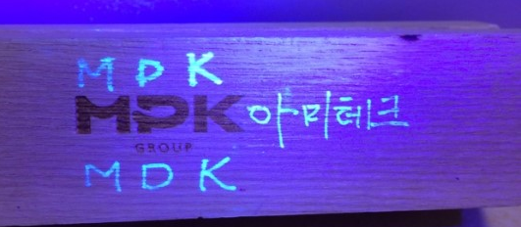
Visual Concept
Dots
Brush.

Slide 3



Target Users.
Dots
Brush.
Those who need to discard immediately after writing to maintain security.
Those who want the brush of the painted picture to have movement.
Those who want to hide their meaning through a secret drawing.

Slide 4
Features.
Dots
Brush.
1
You can draw a picture and make the dots of the picture move.
2
You can paint pictures that you can't see without UV light.
3
You can paint a picture that disappears over time.
4
You can choose the color, the time to disappear, the spread of the dots, the pen type, and the thickness.

Slide 5
Algorithm.
Dots
Brush.
#Dots_Movement
For every dots
if pointer, pointerCenter distance <= spread
N
draw pointer and move a little
Y
set pointer as pointerCenter
if pointer, pointerCenter distance <= spread
Y
cancel move

Slide 6
Algorithm.
Dots
Brush.
#Dots_Drawing
For every dots of Secret Pen
if uv light is on
N
if distance <= 50 && brush is secret pen
Y
Y
draw every dots
draw dot in distance, with color by distance

Slide 7
Algorithm.
Dots
Brush.
#Dots_Drawing
For every dots of Timeout Pen
set dot size as frameCount – frame when making
if frameCount – frame when making >= duration
Y
remove info of array

Slide 8
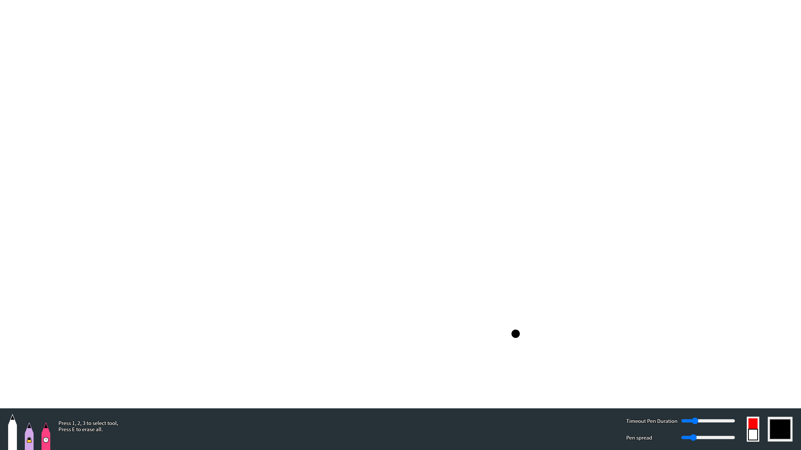
Screenshots.
Dots
Brush.

Slide 9
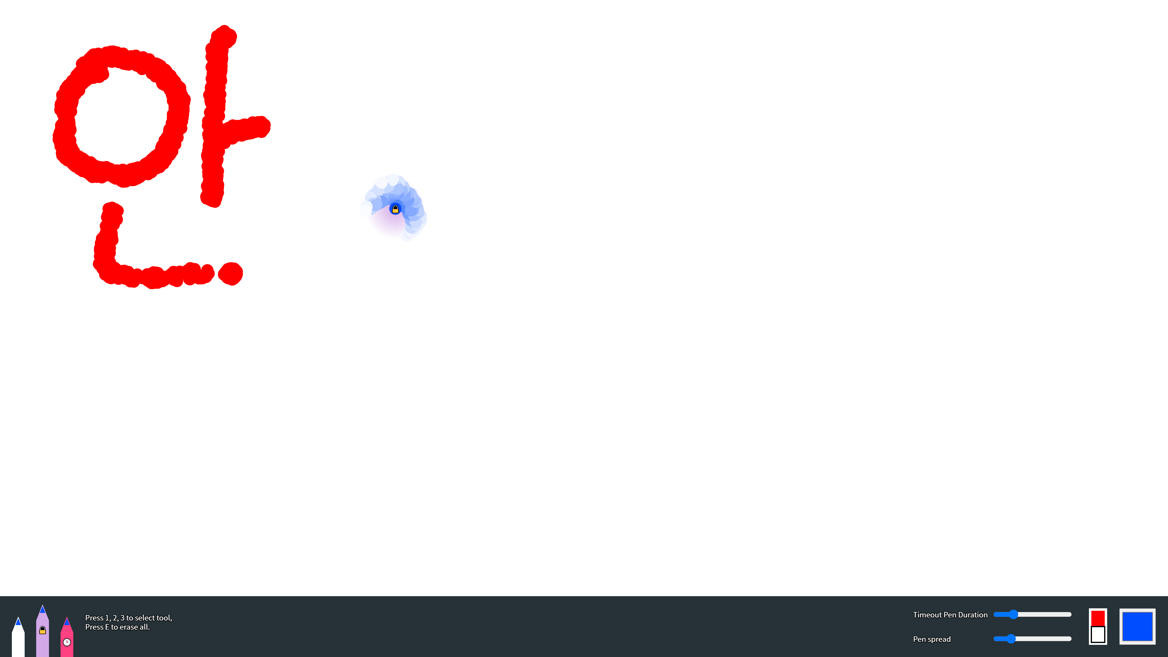
Screenshots.
Dots
Brush.

Slide 10
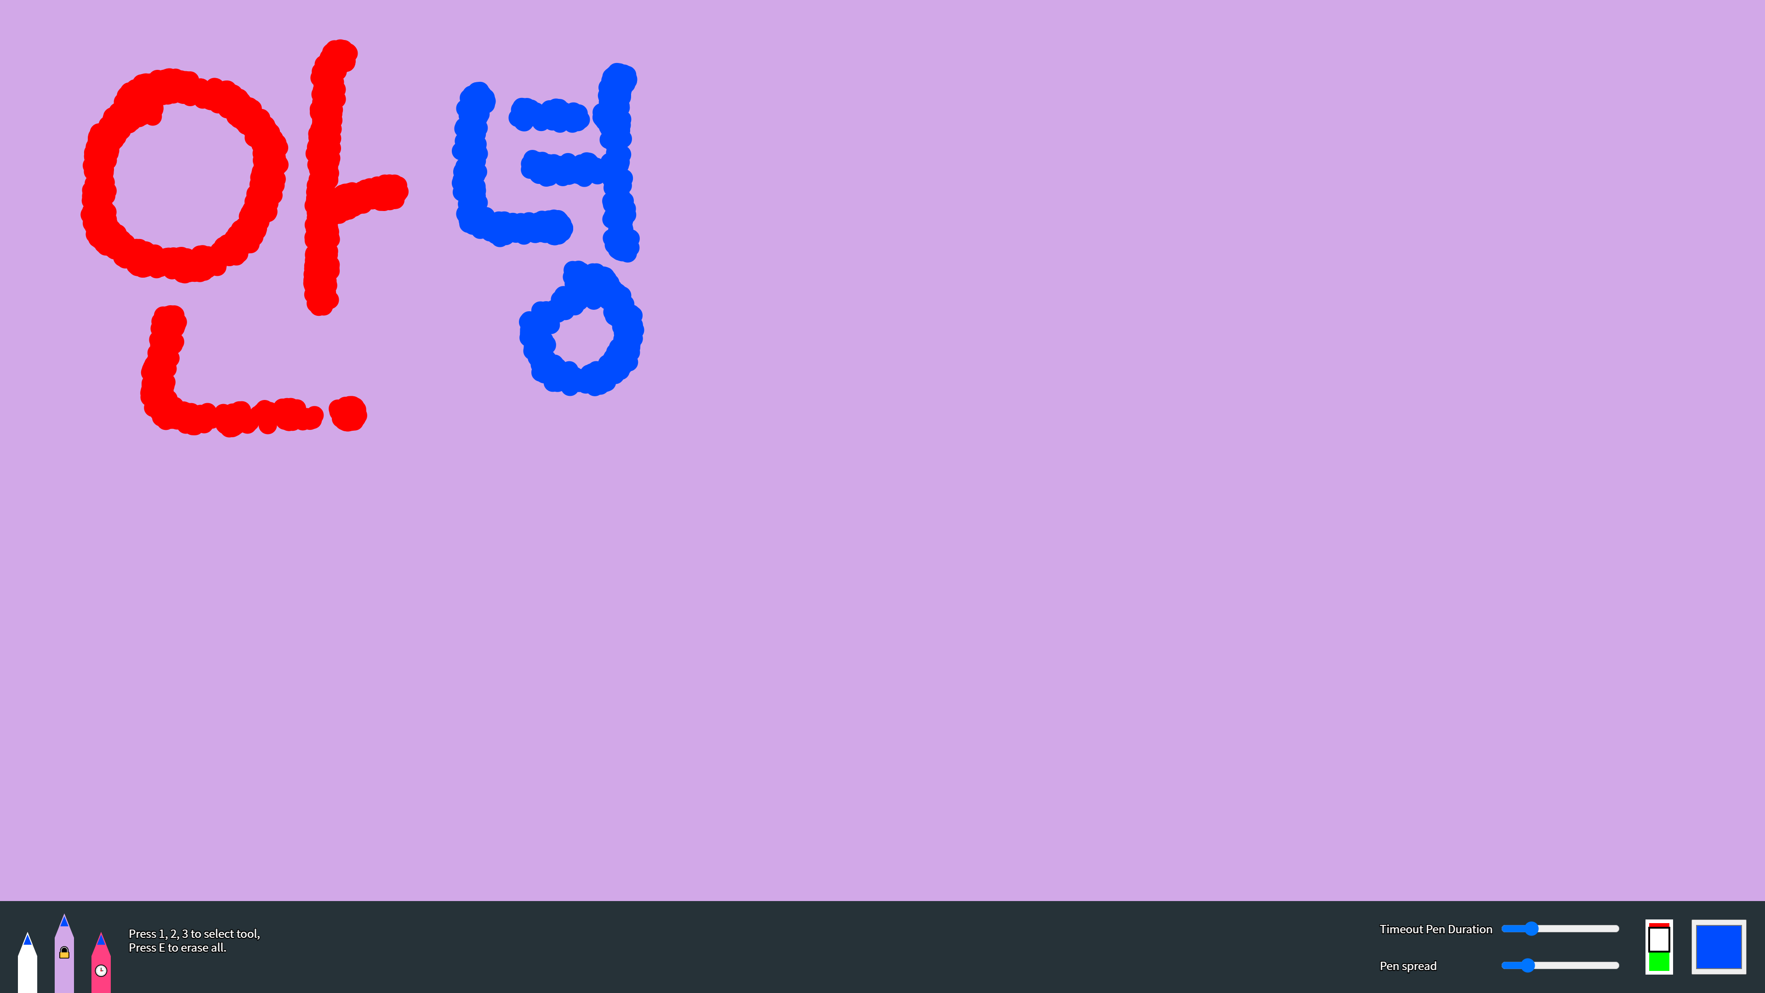
Screenshots.
Dots
Brush.

Slide 11
Screenshots.
Dots
Brush.

Slide 12
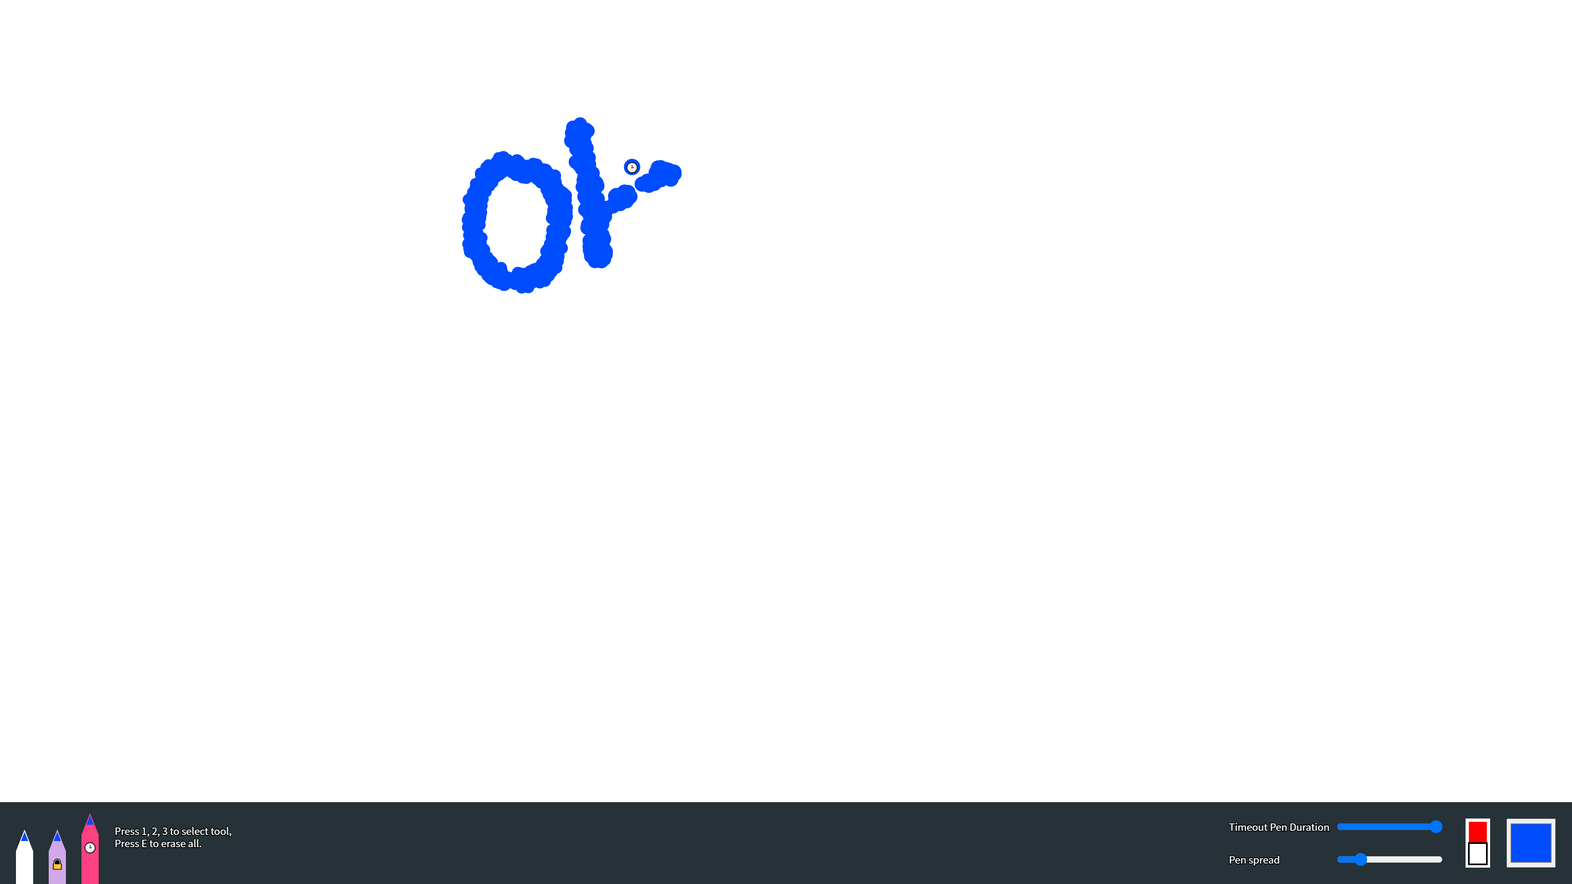
Screenshots.
Dots
Brush.

Slide 13
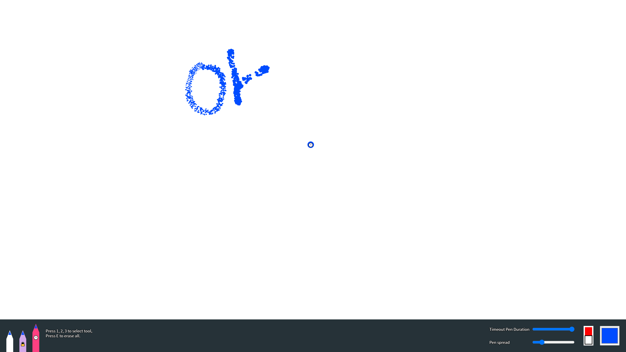
Screenshots.
Dots
Brush.

Slide 14
Thank You.
#09
Find out my project :)
https://ienground.github.io/p7_CC/

